Slide 1
EDGE DETECTION USING IMAGE GRADIENTS (REF.CANNY)
YEMISI TEJU OLASOJI
DANIEL FYLLING

Slide 2
Aims of the project: Explain the theory of edge detection, Evaluate Canny’s performance on different edges &scales and noise levels. Compare Canny with the Sobel edge detector
What is an Edge?
An edge is a location where there is a rapid change in image intensity
Causes of Edges?
Surface and depth discontinuity; illumination discontinuity etc
Types of Edges:
Roof edge, step edge and line edge
What is Edge Detection?
An essential image processing technique commonly employed in various computer vision applications e.g. feature extraction. It reduces noise and enhances accuracy& performance of computer vision applications
Edge detection using image gradients uses the first derivative of the image called the gradient operator which can be implemented as a convolution
Quality of a good edge detector:
A good edge detector should produce the edge position, the edge magnitude i.e. strength and the edge orientation i.e. direction

Slide 3

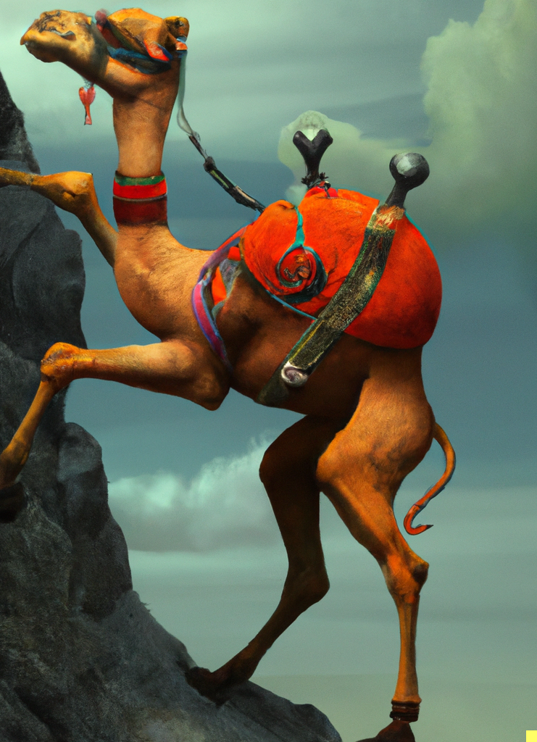
Experiments Overview
Effect of Smoothing
Gaussian smoothing of various kernel sizes
Effect of Noise
Gaussian noise at different intensities
Effect of Different Scales
Comparison with Other Edge Detection Methods
Sobel
Prewitt
Laplacian of Gaussian

Slide 4
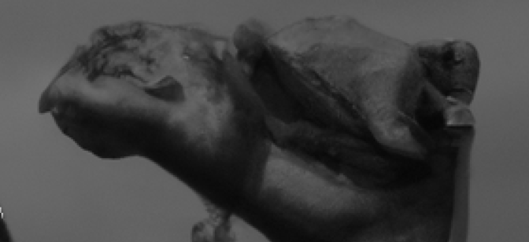
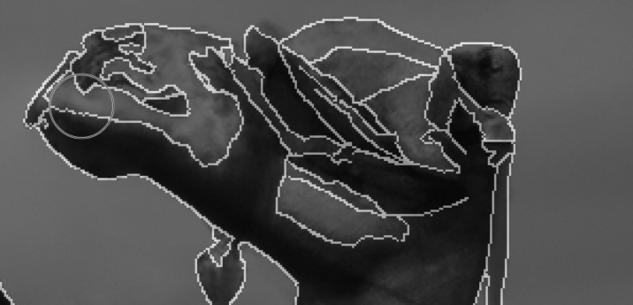
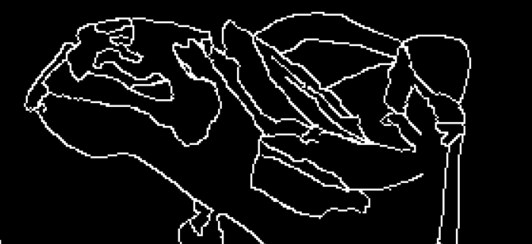
Evaluation Metrics
Ground Truth Image
Generated manually
Used as “gold standard”
Precision
Rate of “hits” to total guesses
Recall
Rate of hits to total possible hits
F1-score
Balance between the two

Slide 5
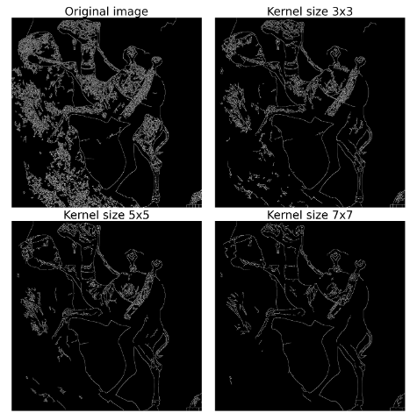
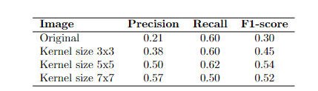
Effect of Smoothing
Apply Gaussian smoothing
3x3
5x5
7x7
Compare against unsmoothed image
Visual and numerical results coincide
Some smoothing is good
Too much of a good thing is bad
Carry forward 5x5 for reference

Slide 6
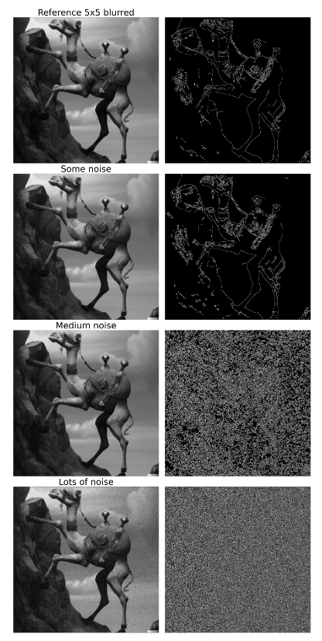
Effect of added noise
Added Gaussian noise
“Some”
“Medium”
“Lots”
Minimal visual difference
Compared against same “ground truth”
Numbers and visuals agree
Result underline importance of smoothing

Slide 7
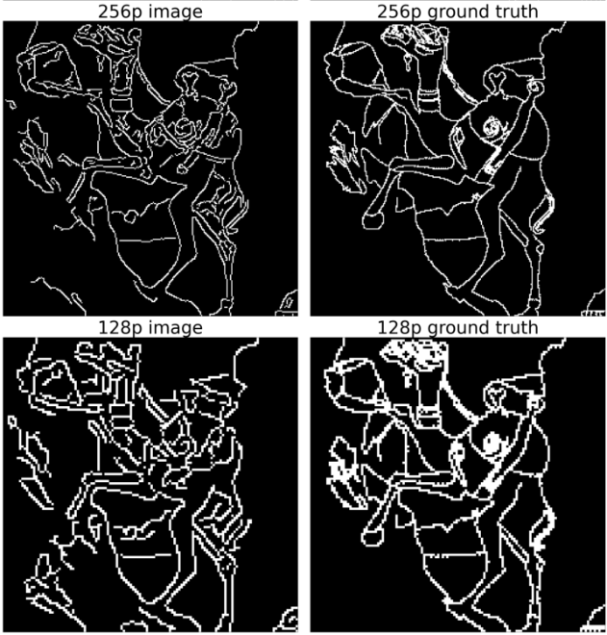
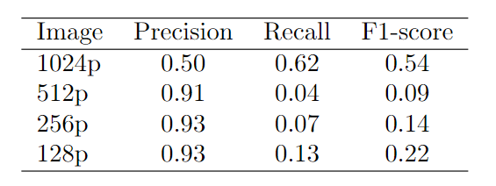
Effect at Different Scales
Down scale image and ground truth
1024p – original
512p
256p
128p
Results do not align with expectations
“Lazy” downsized ground truths
Lesson learned:
Ground truth attentiveness

Slide 8

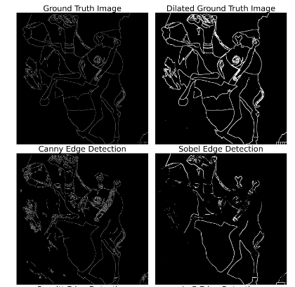


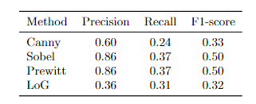
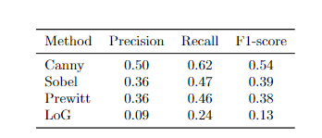

Comparison between different methods
Canny as reference
Sobel
Prewitt
Laplacian of Gaussian
VS two different ground truths
Single pixel – original
3x3 dilated version
Results show that there is no single approach to best results

Slide 9
Summary
Some smoothing is essential
Diligence in approach
Choose the right tool for the job
“Negative” results present unique learning opportunities
The journey is truly the goal

Slide 10
Thank you
…for your time and attention

